Slide 1
Yet Another VPS
Zuoxiu Xing
200362635

Slide 2
Introduction
What is it?
A web portal built upon OpenStack that provides self-service ability
Why I am doing this?
Learning cloud technologies
Who is the user?
People who have little knowledge of OpenStack and infrastructure setup
Demo!

Slide 3
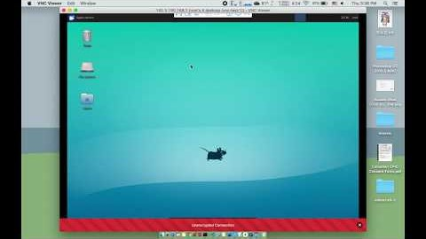

Slide 4
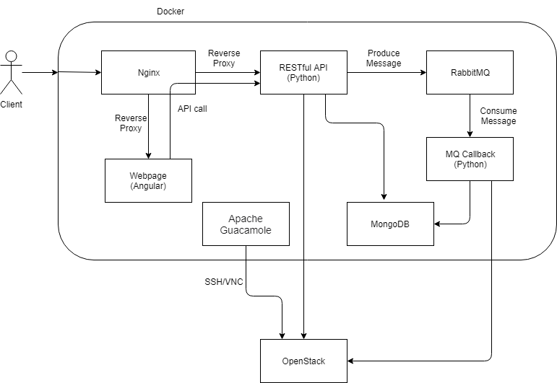
Architectural Design

Slide 5
OpenStack
What is OpenStack?
OpenStack controls large pools of compute, storage, and networking
Why OpenStack?
DRY
Save time

Slide 6
Docker
Why using Docker?
Easy deployment

Slide 7
Nginx
What is Nginx?
Open source software for web serving, reverse proxying, caching, load balancing, media streaming, etc.
Functionality
Gateway and functionality
Why?
Lightweight
Easy setup
Cross-origin resource sharing
location / {
proxy_pass http://webpage:4201;
}
location /api {
proxy_pass http://api:5000/api;
}

Slide 8
Front-end (Angular)
Why Angular?
Previous experience with AngularJS
Component based
Material design
Angular CLI
Both unit test and end to end test
Notes:
First of all, I have previous experience with AngularJS, which is the 1.x version. Then Google rewrote the entire framework with typescript
Second, it is component based. It makes easier to develop front end since every UI element can be a component
Third, it has Google's material design so that I don’t need to find another CSS library
And Angular CLI to generate component, serving the app, etc. Just makes life easier

Slide 9
RESTful API (Python Flask)
Why RESTful API?
Flexibility
Automation
Front-end backend separation
Why Flask?
Python
Lightweight

Slide 10
Message Queue (RabbitMQ)
Why using message queue?
Queue time-consuming tasks for faster response time
Why RabbitMQ?
Used by OpenStack

Slide 11
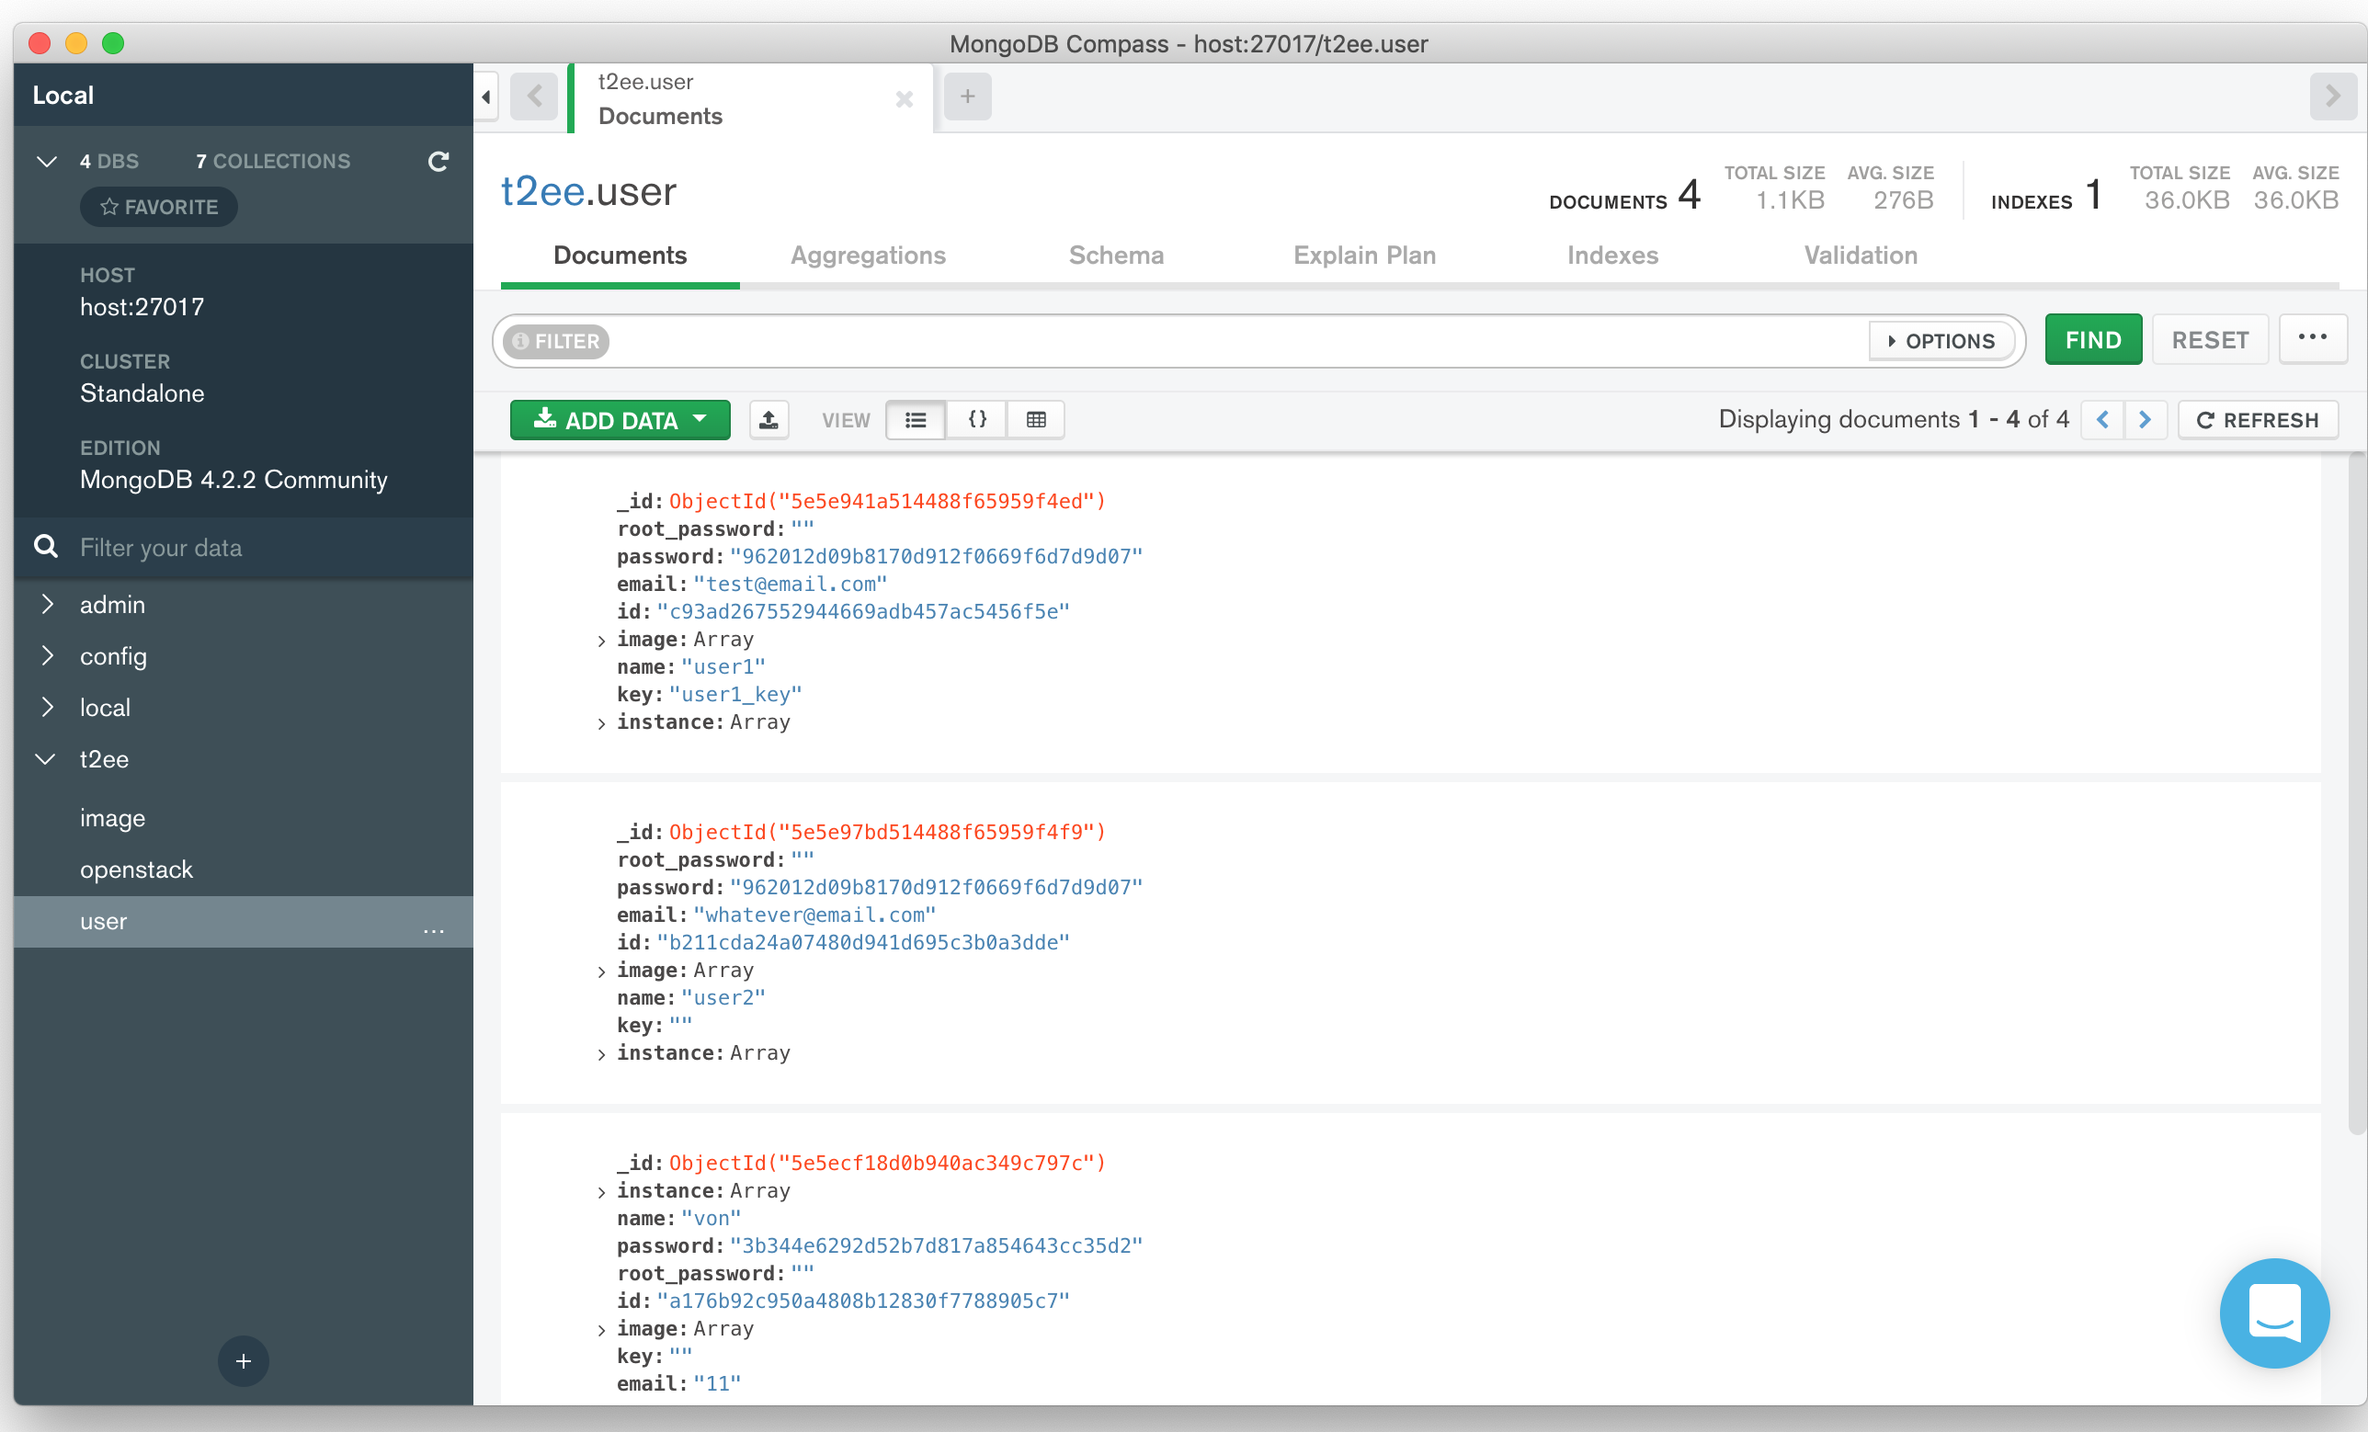
MongoDB
Why MongoDB?
Document-oriented
Learning NoSQL

Slide 12
Apache Guacamole
What is Guacamole?
A clientless remote protocol gateway running on browsers
Why adding Guacamole?
Connect to virtual machines anywhere with only a browser
Why is not working?
Working as standalone project but cannot integrate into the project

Slide 13
Project Roadmap
Infrastructure Setup
Middleware Setup
Backend Development
Front-end Development

Slide 14
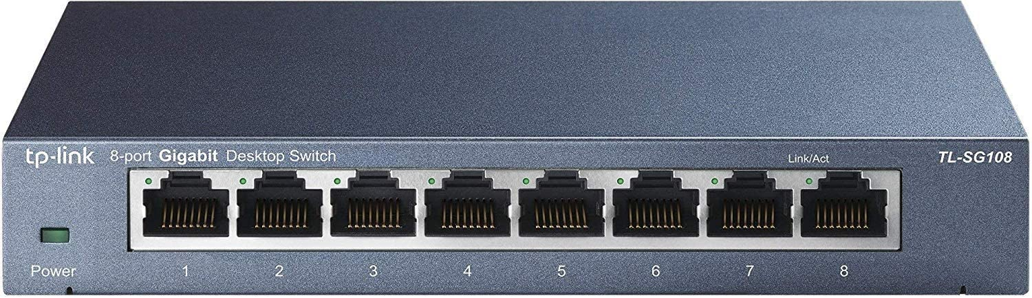
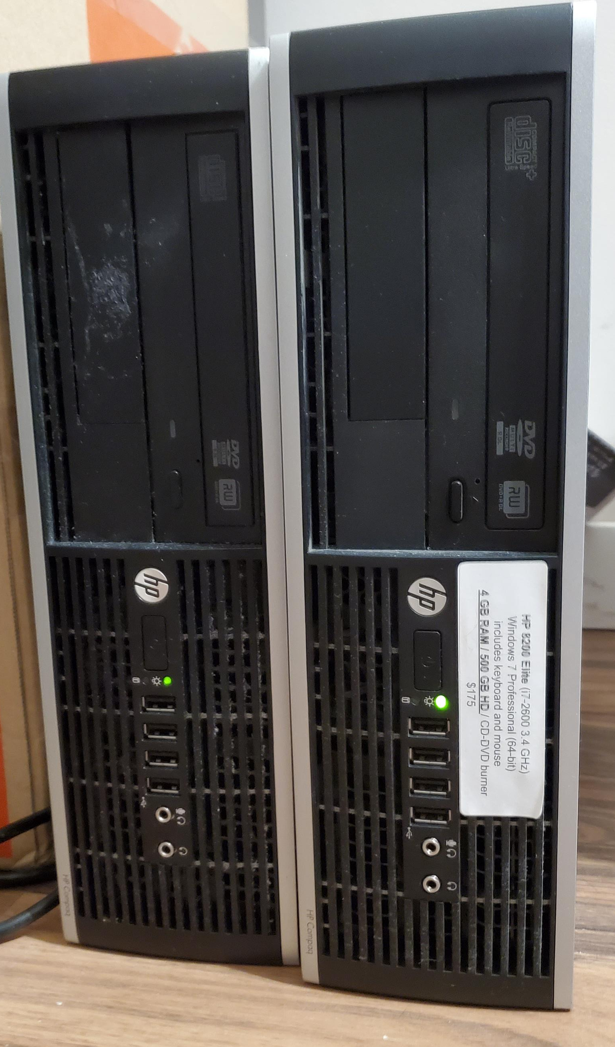
Infrastructure Setup
Setup two used PCs and installed CentOS 7
Installed and configured OpenStack
Nova (Compute)
Glance (Image)
Neutron (Network)
Keystone (Identity)
Installed Docker and created Docker files
Moved on campus and re-configured network

Slide 15
Middleware Setup
Added MongoDB into the project
Added RabbitMQ into the project
Added and configured Nginx as the reverse proxy

Slide 16
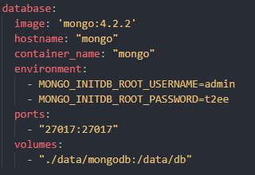
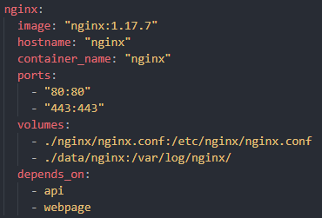
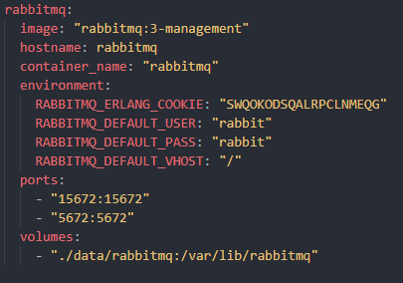
Middleware Setup
Docker Compose
Tool for defining and running multi-container Docker application
YAML file

Slide 17
Backend Development
Developed own library to control OpenStack
OpenStack SDK
Developed RESTful API to utilize the library
Flask
Developed callback function that consumes messages
Pika

Slide 18
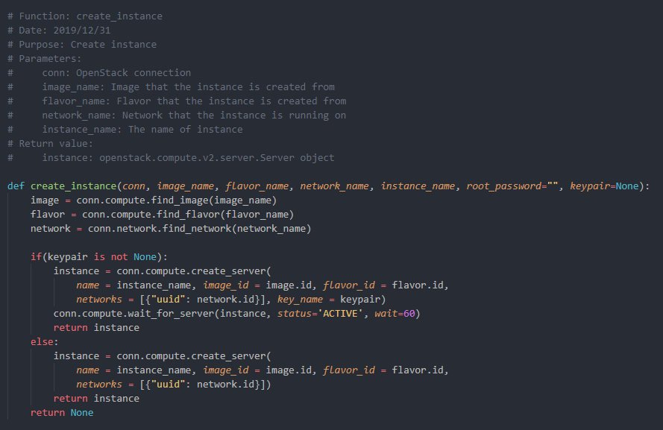
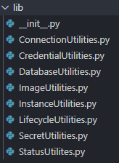
Library
Separated into different utilities
Be called by RESTful API and Callback function

Slide 19
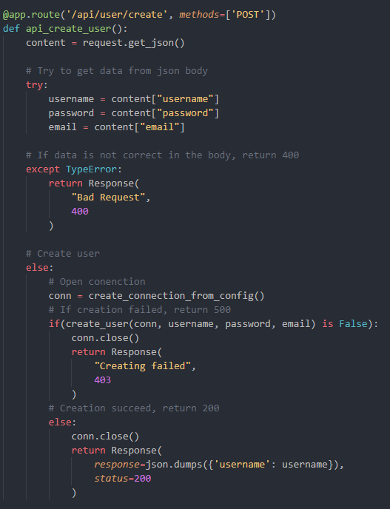
RESTful API
Calling function in the library
Separated based on URL route

Slide 20
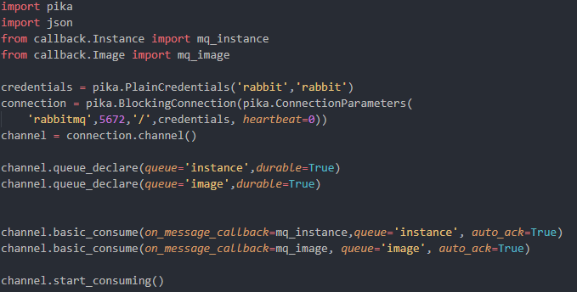
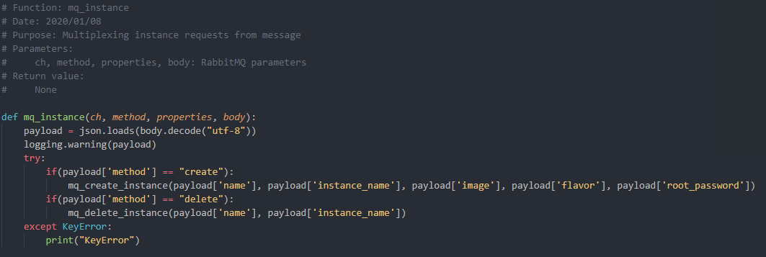
Callback Function

Slide 21
Front-end Development
Developed the front-end using Angular
Utilizing RESTful API

Slide 22
Overall Experience
Software Development Cycle
Compromises
Technologies

